Slide 1
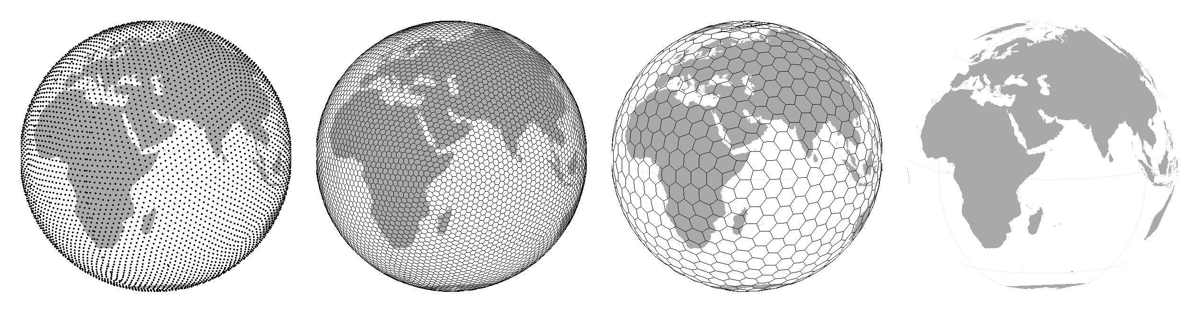
Spatial Ecology and Macroecology
Petr Keil
Notes:
Hi, my name is Petr Keil and this is my project Biodiversity dynamics across a continuum of space, time, and their scales.

Slide 2
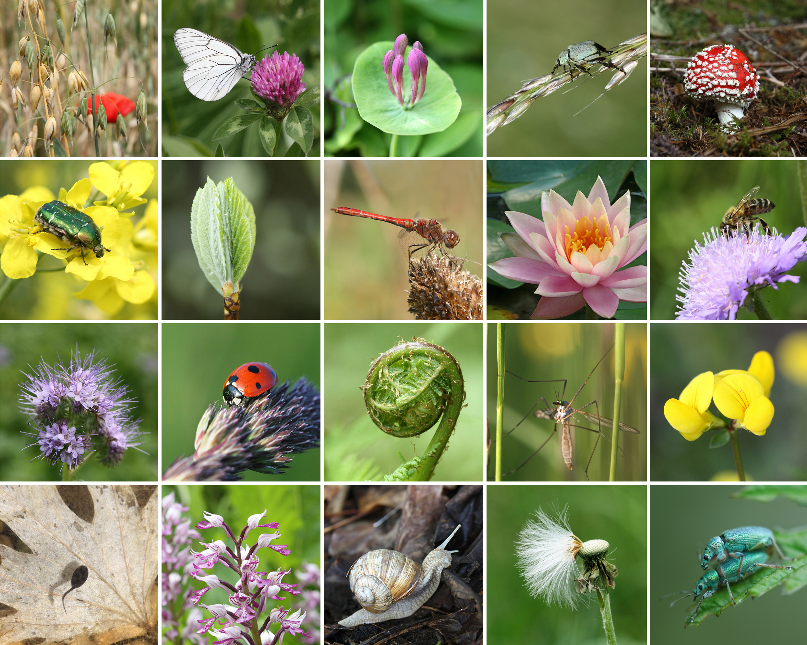
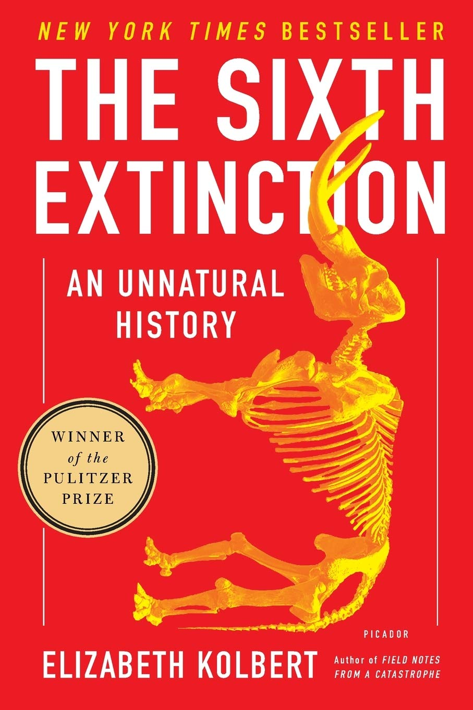
Big slide
Many references
Notes:
In this panel we can probably all agree that biodiversity is one of the most valuable natural resources.
But things like climate change or habitat loss are a threat to biodiversity, to the extent that we hear about biodiversity crisis, or sixth mass extinction
For example, about 1% of vertebrate species have gone extinct because of humans

Slide 3
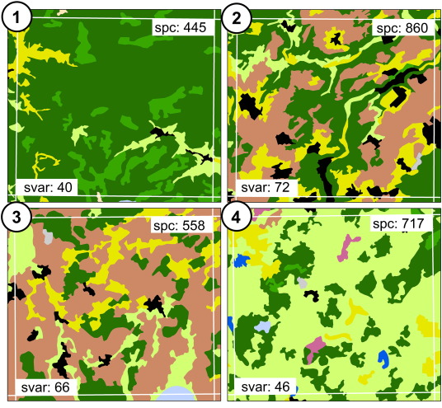
XXX
SSS (2010) Ecol. Informatics
SSS (2011) Rem. Sens. Environ.
Notes:
OK, so here we are moving to the outer space
Spaceborne satellite sensors such as MODIS or Landsat can classify landscape to spectral species, and can measure spectral diversity
Unlike taxonomic data, spectral data suffer no sampling bias and are available over any scale
In WP4 I will seek parallels between dynamics of taxonomic and spectral diversity

Slide 4
Objectives
XXXX
XXX
XXX X
XXX
Local
Global
Notes:
And this is what I will address
The grand objective is to figure out…
Specifically, BEAST will ………………………
I will do this in 5 work packages.

Slide 5
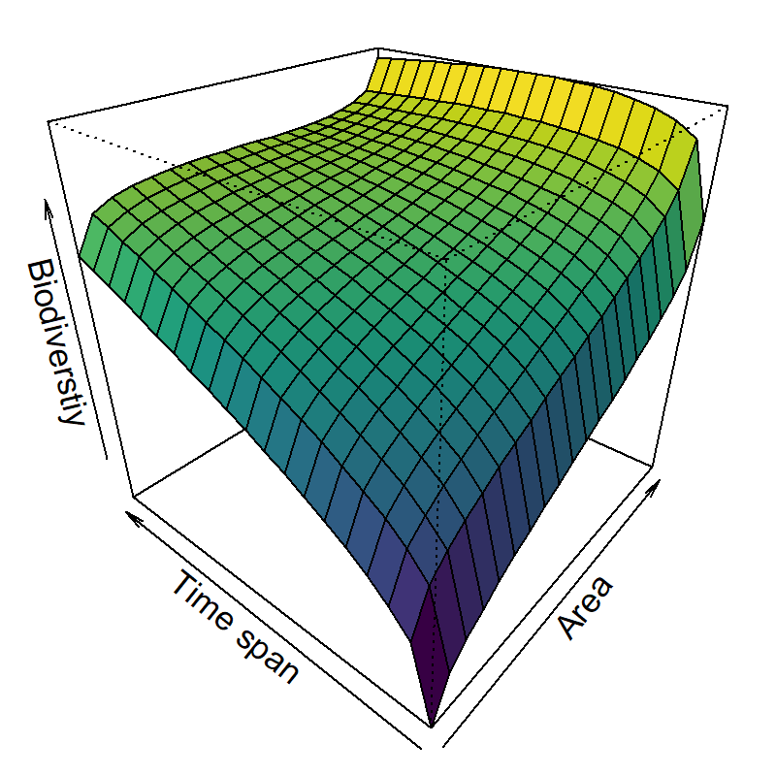



XXXX
Rescaled # of species
Hierarchical
cross-scale
model
Rescaled Area
XXX et al. (XXX) XXX
Notes:
But BEAST focuses on temporal change, so I need biodiversity laws in space and time
For example, diversity should increase with both area and time span
In the proposal I describe at least 4 other potential laws
For all of them we have theoretical reasons that they should hold, but we lack empirical tests, and we don’t know their exact shape
In WP2 I will test generality these laws, using the high-quality data.
This can be big news for basic macroecology

Slide 6
Inter slide
Notes:
Finally, in WP5 I will put everything together

Slide 7
Inter slide
Subheading
Notes:
I am qualified to deliver all this

Slide 8

XXX
XXXX
XXX
XXX
XXX
XXX
Notes:
I published on biodiversity scaling, change, extinctions
I developed statistical and machine learning tools for macroecology
I know biodiversity informatics and geographic information systems
(Honestly, this is a combined expertise that is rare in my field)

Slide 9

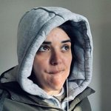

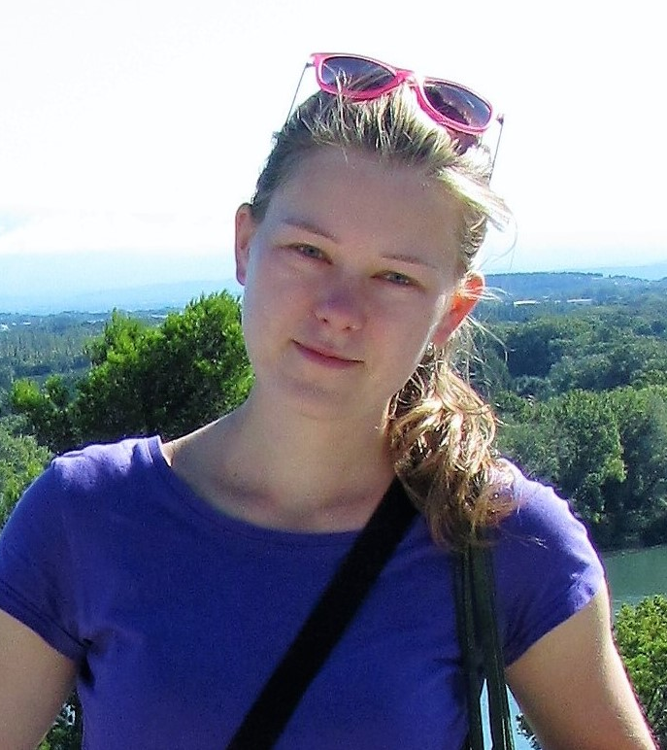
Theme x
XXX
XXX (XXX)
XXX
xxx
Photos
Notes:
These are also topics that we study in my research group.

Slide 10
Thank you. Questions?

